Slide 1
19PHY102 Engineering Physics B Unit V : Solid State Physics

Slide 2
Objectives
Learn about effective no. of atoms in different unit cells, relation connecting radius of atom and the lattice parameter
Atomic Packing Fraction of different cubic systems, HCP and Diamond structures

Slide 3
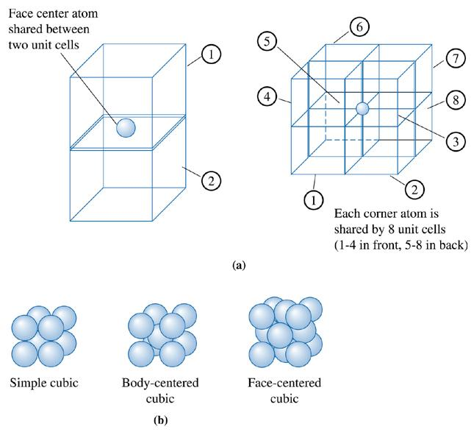
Number of Lattice Points in Cubic Crystal Systems
If there is only one atom located at each lattice point,
Sharing of corner atoms

Slide 4
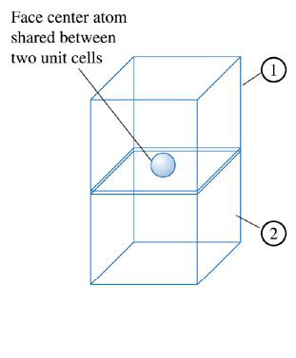
Number of Lattice Points in Cubic Crystal Systems
In the Simple Cubic unit cell:
lattice point / unit cell = (8 corners)1/8 = 1
In BCC unit cells:
lattice point / unit cell = (8 corners)1/8 + (1 center)(1) = 2
In FCC unit cells:
lattice point / unit cell = (8 corners)1/8 + (6 faces)(1/2) = 4
The number of atoms per unit cell would be 1, 2, and 4, for the simple cubic,
body-centered cubic, and face-centered cubic, unit cells, respectively.

Slide 5
Relationship between Atomic Radius and Lattice Parameters
Simple Cubic :
we find that atoms touch along the edge
of the cube in SC structures

Slide 6
Relationship between Atomic Radius and Lattice Parameters
Body Centered Cubic :
In BCC structures, atoms touch along the body diagonal. There are two atomic radii from the center atom and one atomic radius from each of the corner atoms on the body diagonal, so
a

Slide 7
Relationship between Atomic Radius and Lattice Parameters
Face Centered Cubic :
In FCC structures, atoms touch along the face
diagonal of the cube.
There are four atomic radii along this
length—two radii from the face-centered atom
and one radius from each corner, so:
a

Slide 8
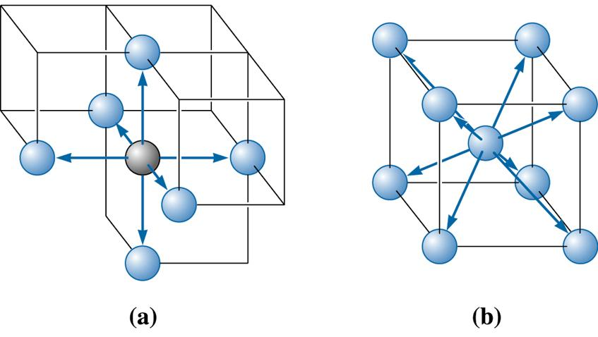
Coordination number
Coordination number is the number of nearest neighbour to a particular atom in the crystal
Simple Cubic :
The coordination number of SC crystal is 6.
Six atoms touch each atom in Simple Cube

Slide 9
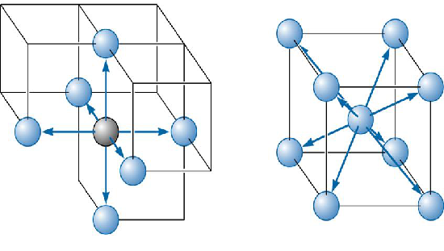
Coordination number
Body Centered Cubic :
The coordination number of BCC crystal is 8.
The body centered atom is in contact with all the eight corner atoms. Each corner atom is shared by eight unit
cells and hence, each of these atoms is in touch with eight body centered atoms

Slide 10
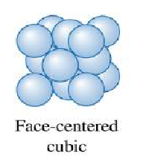
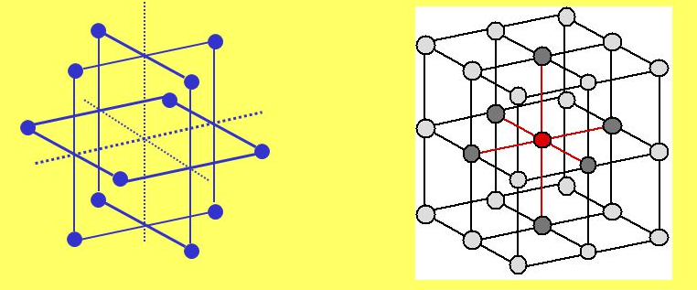
Coordination number
Face Centered Cubic :
In the FCC lattice each atom is in contact with 12 neighbor atoms. FCC coordination number
Z = 12
For example, the face centered atom in the front face is in contact with four corner atoms and four other face-centered atoms behind it (two sides, top and bottom) and is also touching four face-centered atoms of the unit cell in front of it.

Slide 11
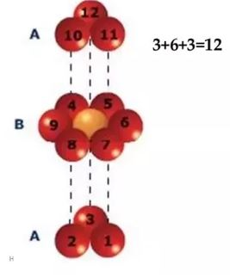
Coordination number
Hexagonal Close Packed Structure :
In Hexagonal (HCP ) lattice Z = 12.
The center atom of the top face is in touch with six corner atoms, three atoms of the mid layer and other three atoms of the mid layer of the
unit cell above it.

Slide 12

Atomic packing factor
Atomic packing factor (APF) or packing efficiency indicates how closely atoms are packed in a unit cell and is given by the ratio of volume of atoms in the unit cell and volume of the unit cell
Atomic packing factor,

Slide 13
Atomic packing factor
Simple Cubic :
Considering the atoms as hard spheres of radius, r
Volume of the atom =

Slide 14

Atomic packing factor
Body Centered Cubic :

Slide 15
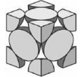
Atomic packing factor
Face Centered Cubic :
In the FCC unit cell effective number of atoms =
8 corner atoms x (1/8) (each atom is shared by 8 unit cells)
+ 6 face centeredatoms x1/2 (each shared by two unit cells) = 4

Slide 16
Close-Packed Structure
FCC and hexagonal crystal structures are most highly packed with packing efficiency of 74% (APF= 0.74). Such structures can be described in terms of close-packed atomic planes.
In FCC, {111} planes are close-packed and the basal plane (0001) is the close-packed one in hexagonal close-packed (HCP) system. Therefore, both of these structures can be generated by stacking of these planes.

Slide 17
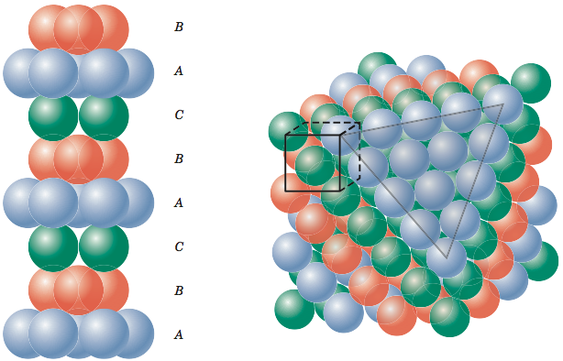
Close-Packed Structure
FCC, {111} planes
In FCC, atoms in the third layer sit over the c sites and this repeats giving rise to ABC ABC ABC type of stacking
A portion of such a stack is shown in the picture

Slide 18
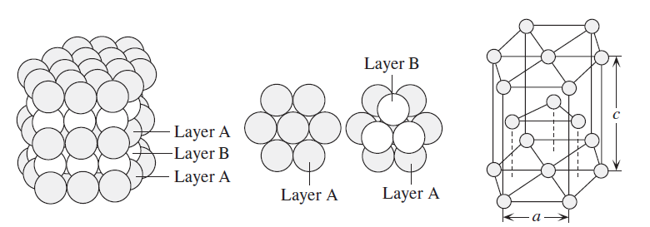
Close-Packed Structure
In Hexagonal Close Packed (HCP) system, centers of atoms of the third layer lie directly over centers of atoms of the first layer (a positions) giving rise to
AB AB AB type of stacking.
(0001) plane HCP

Slide 19
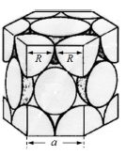
Atomic packing factor
Hexagonal Close Packed (HCP) structure
In the Hexagonal unit cell,
number of atoms = 12 corner atoms × 1/6 (shared by six unit cells)
+ Two face atoms × 1/2 + 3 interior = 6.
2r = a

Slide 20
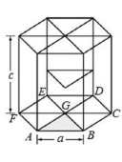
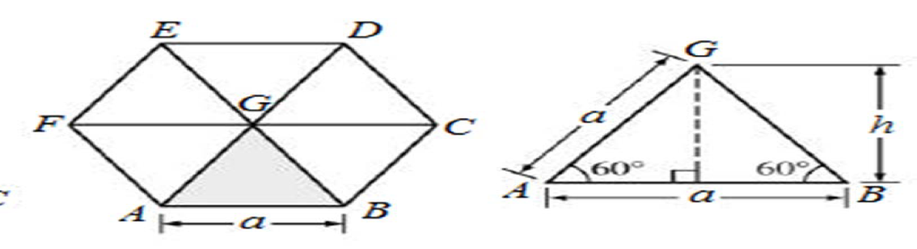
Atomic packing factor
Hexagonal Close Packed (HCP) structure
Unit cell volume = Area of the hexagon × height
= Area of the six triangles × height (c)
= ( 6 × Area of Δ AGB) × c
= (6 × ½ × a × h) × c
= (3 × a × a sin60°) × c
= 3a² c sin60°

Slide 21

Atomic packing factor
Hexagonal Close Packed (HCP) structure
For an ideal hexagonal crystal c/a ratio = 1.633

Slide 22
Hexagonal Close Packed (HCP) structure
Give a Try : c/a = 1.633
1. Each basal plane has nearest neighbor atoms making equilateral triangles.
So, a=2r (where r is the sphere radius).
2. Each atom at height c/2 above the basal plane is positioned directly above the centroid of the triangles in the base plane. For an equilatreral triangle, the distance from a vertex to the centroid is two-thirds the length of the median, and is hence
( 2 / 3 ) × ( a √ 3 / 2 ) = a / √ 3
3. Each atom in the base plane has a nearest neighbor in this middle plane. So, the distance from the corner atom in the base plane to the nearby atom in the mid-plane is 2r.
4. This distance can also be calculated from Pythagoras, giving:
4r² = a² = ( a / √ 3 )² + ( c / 2 )²

Slide 23
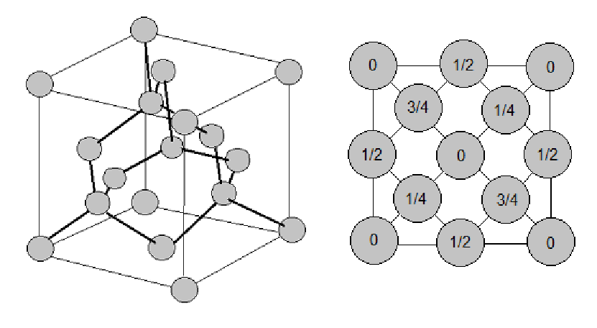
Atomic packing factor
Diamond structure :
Projection View

Slide 24
Atomic packing factor
Diamond structure :
Diamond Structure : FCC unit cell + 4 extra atoms
No. of atoms in the unit cell = 1/8 × 8 (corner atoms) + 1/2 × 6 (face centered atoms)
+ 4 (atoms inside the unit cell)
= 1 + 3 + 4
= 8

Slide 25
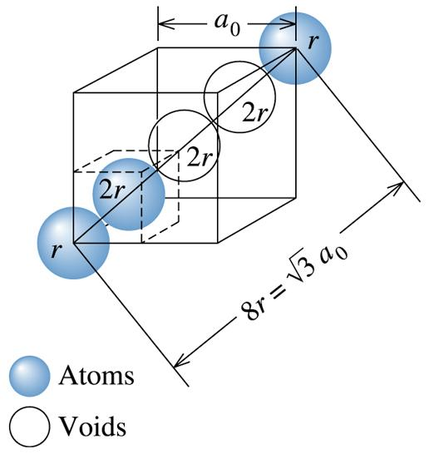
Atomic packing factor
Diamond structure :
To get the relation between the radius of the atom
and the lattice parameter, add two voids
diagnally in the unit cell at
(1/2,1/2,1/2) and (3/4,3/4,3/4) positions
as shown in the figure

Slide 26
Atomic packing factor
Diamond structure :

Slide 27
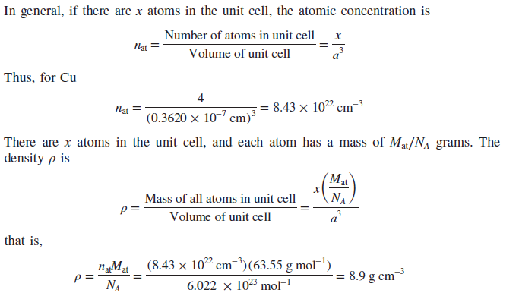
Problems
Calculate the atomic concentration (number of atoms per unit volume) in Cu and the density of the crystal given that the atomic mass of Cu is 63.55 g mol⁻¹ and the radius
of the Cu atom is 0.128 nm.
Solution:

Slide 28
Problems
The lattice constant of Si is 5.43 Å . What will be the radius of a silicon atom? Calculate the theoretical density of silicon. The atomic mass of Si is 28.1 gm/mol.
SOLUTION:
For the diamond cubic structure,
Therefore, substituting a = 5.43 Å,
the radius of silicon atom = 1.176 Å .
There are eight Si atoms per unit cell.

Slide 31
